Slide 1


Boba Trivia Tournament
Vy Nghiem – tnghiem@gmu.edu

Slide 2
• Project / App name: Trivia Tournament
• Description: Originally, the app was built to be a simple tool for entertainment as it could draw random trivia questions (and answers) for the user. In the second half of this IT315 course, the app is modified and upgraded to focus on display information of a specific subject – Bubble Tea stores in the DMV area. The app has a minimalist design with a pastel color scheme that allows user to navigate around easily.
• Targeted audience: For Phase 2, the app focuses on young adults and adults (both female and male) who like to drink bubble tea in the DMV area.

Slide 3
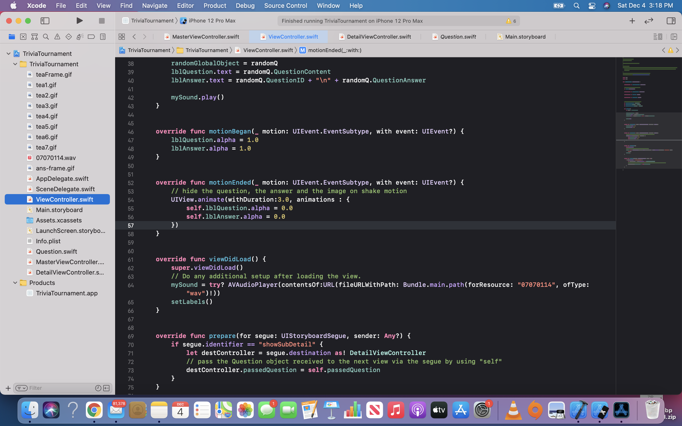
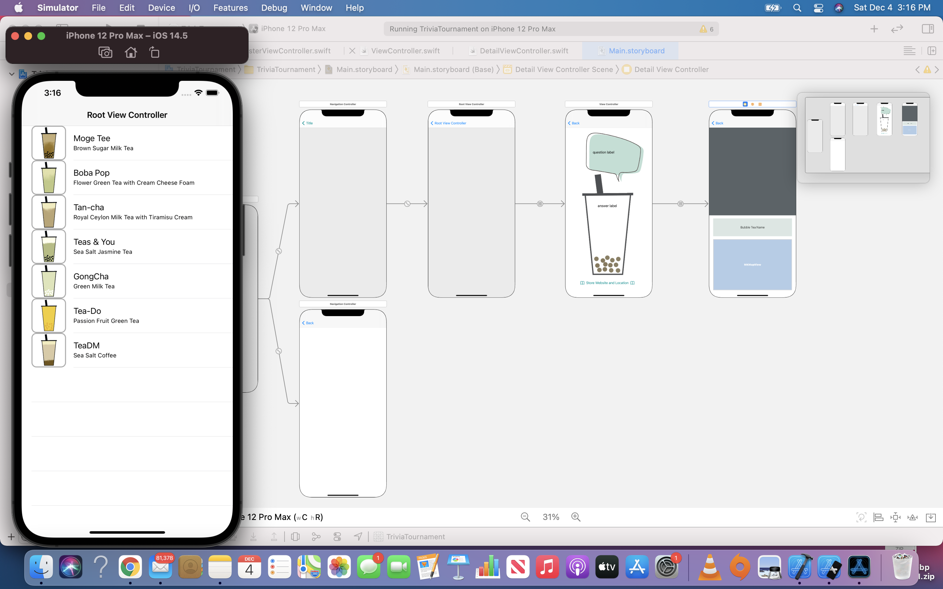
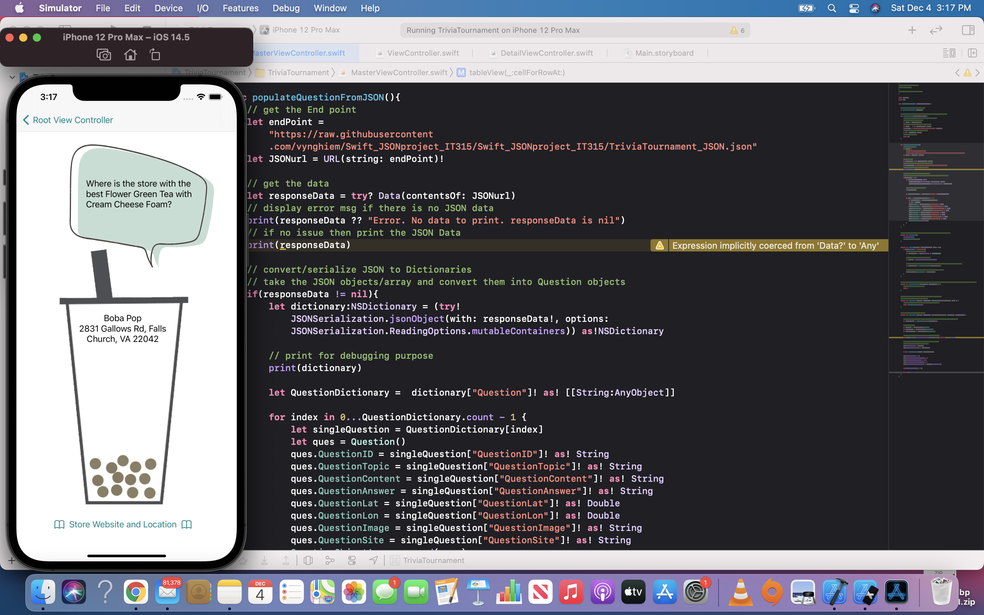
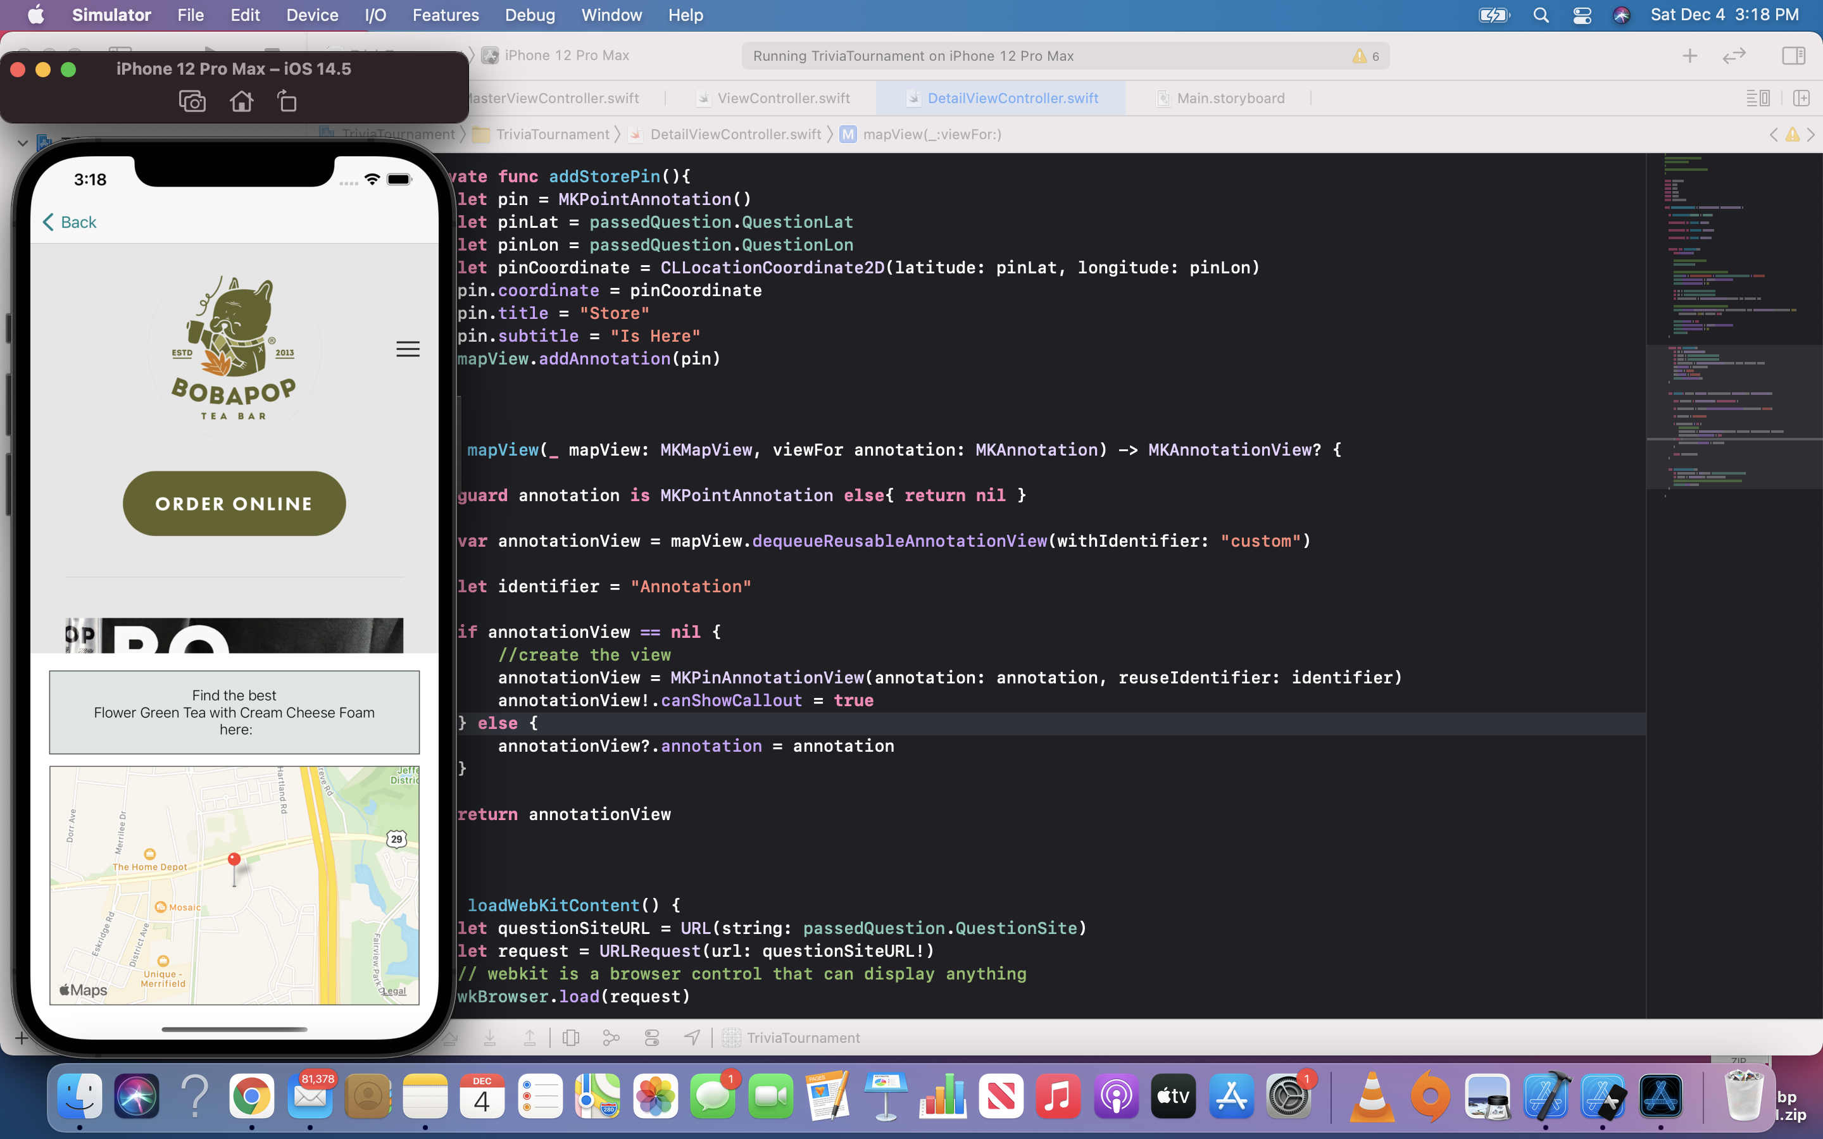

Slide 4
Key concepts learnt in class
UIImages
Motion
Sound
Master detail views - Split view controller
Segues
Table layout
Custom cells
Auto layout
JSON Data
WebKit Embedded Control
Maps and Locations

Slide 5
Challenges you faced while building your app and how you overcame them
UIImage: In order to ensure no Copyright issue happens, I have spent more time than expected to create images used in the app.
JSON data: Since I created the JSON in early development stage, as the app has more and more features added, I have to go back and modify the JSON file.
Maps and Locations: Since this is a new concept, I have encountered lots of hardship during the development stage. The textbook does not provide exact explanation and instructions for the feature that I want to include in my app. I have researched several online resources in order to get a better understanding of the Maps concept.

Slide 6
What do you plan to do with the concepts you learnt in the future?
Keep exploring and adding more features to the app.
Re-design the app appearance for a better aesthetic.
Experience with different concepts and ideas for iOS apps.
Upload the app projects to personal GitHub to build an online profolio.

